Slide 1
Water Quality Update for Wahwashkesh Lake
Water quality update for WWK from the Ministry of the Environment Lake Partner Program that includes phosphorus and water clarity is in the AGM package (hand outs).
In 2013, we purchased and sampled with a YSI water quality meter which measures temperature, oxygen, dissolved ions, pH, and oxidation reduction potential.
Sampling continues with the water quality meter in 2014

Slide 2
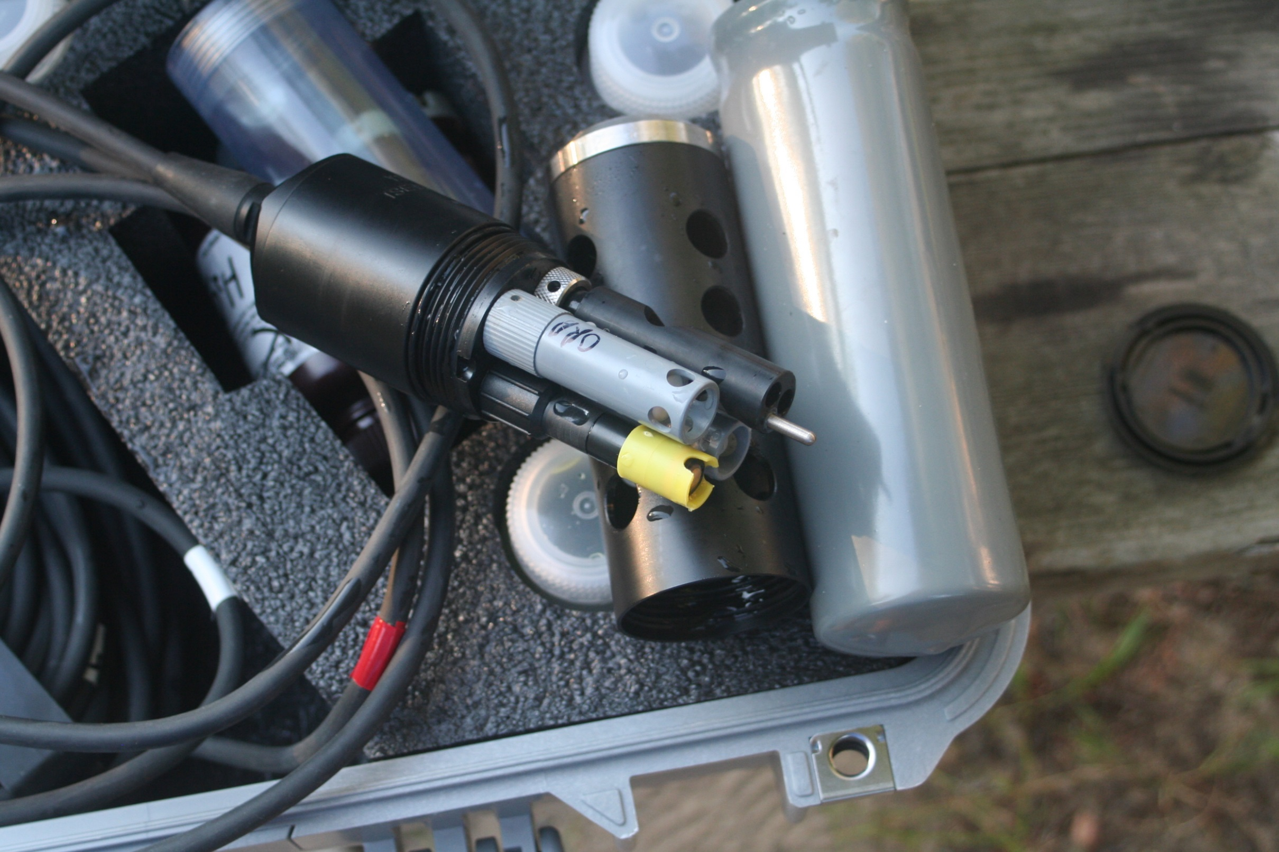

Slide 3
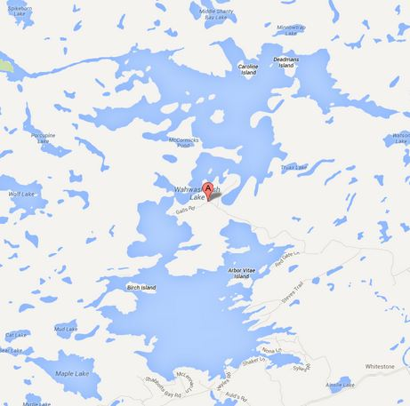
In 2013, took
nearly 1,800
readings
11 sites are
sampled with
the meter
Readings are
taken at 1
meter intervals
(15 meters,
then at 5
meter intervals
2

Slide 5
In late summer 2013, two sites with water quality problems/issues were identified
In the Top Lake where the Magnetawan River enters WWK Lake at Lovesick Rapids, low oxygen readings near the bottom were observed.
Unusual fluctuations in oxidation-reduction potential (ORP).
ORP is a measure of microbial activity, large fluctuations, extremely low or high values indicate potential issues (problems)

Slide 8
At the AGM last year, a cottager indicated family and guest illnesses were due to just washing food with water from Shanty Bay
In August and September 2013, I took readings in Shanty Bay.
Potential issues were identified, including low oxygen in deeper waters and wide fluctuations in ORP

Slide 11
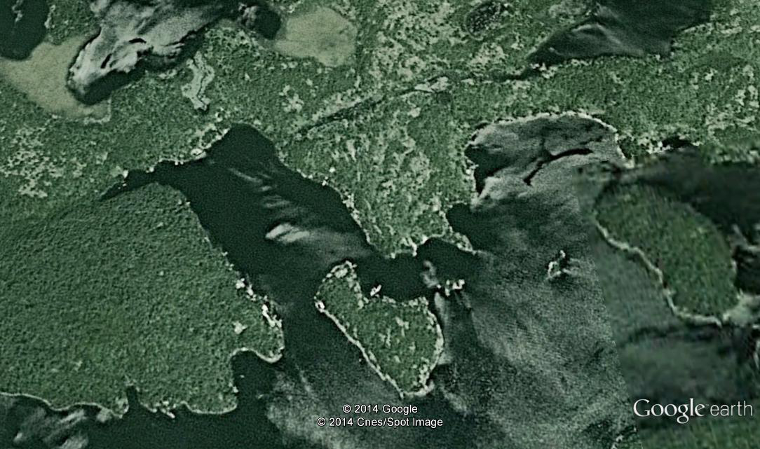
Shanty Bay
Deadman’s
Island
Caroline
Island

Slide 12
Large ground water inputs
Lack of circulation

Slide 13
Shanty Bay
Deadman’s
Island
Caroline
Island

Slide 15
What to do
A decision was made to sample for Escherichia coli or E coli in 2014. Lots of discussion.
Industrial or agricultural waste and discharge not considered a problem.
E coli is a bacteria found in the lower intestine of mammals (humans). E coli is found in septic and sewage water.
E coli can cause poisoning either by ingestion of water or food.
E coli is measured as Colony Formation Units (CFU) as Number of CFU per 100 milliliters (ml) of water

Slide 16
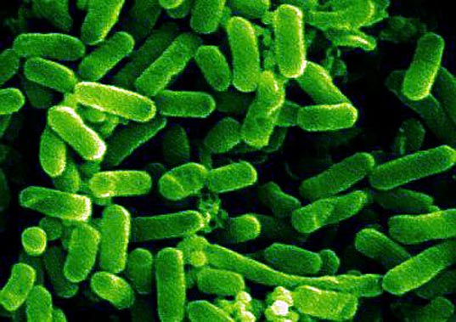

Slide 17
In Ontario, the standard for drinking water is 0 CFU/100 ml
At 100 CFU/100 ml, public swimming beaches are closed.
Three areas have been sampled in 2014 for E coli
Straubs Beach (reference or control site)
Below Lovesick Rapids, Magnetawan River enters the Top Lake
Shanty Bay
Nearly all natural waters contain some E coli

Slide 18
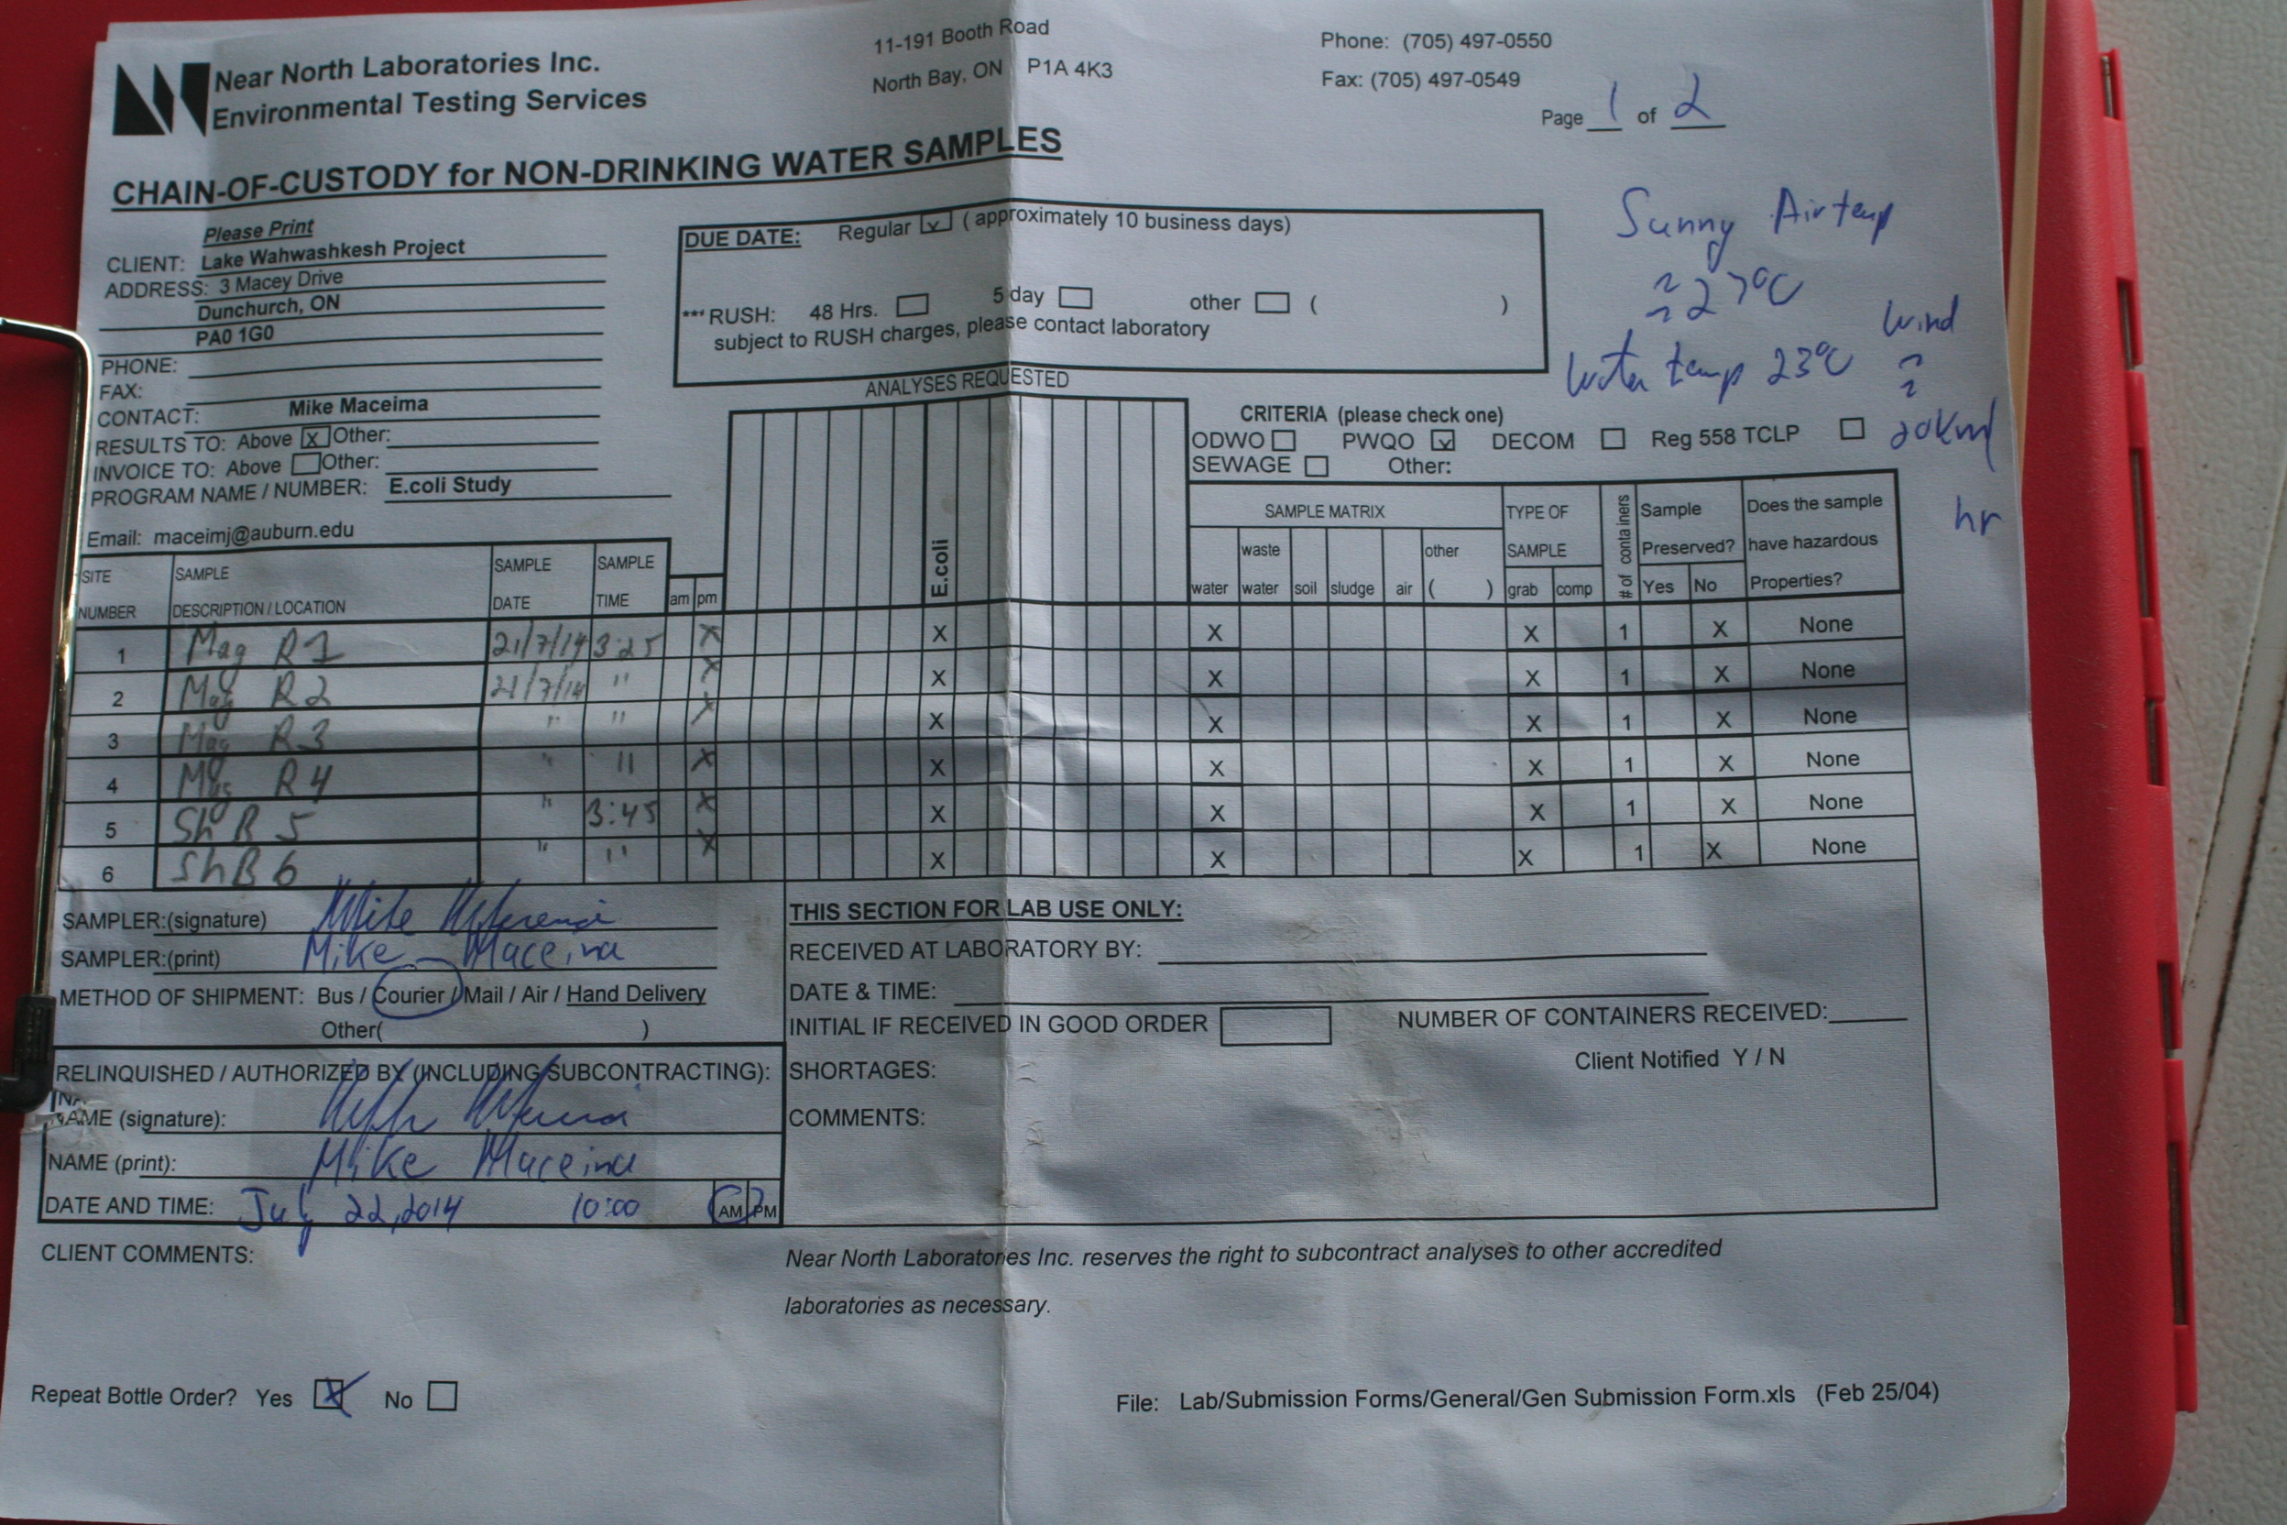

Slide 19
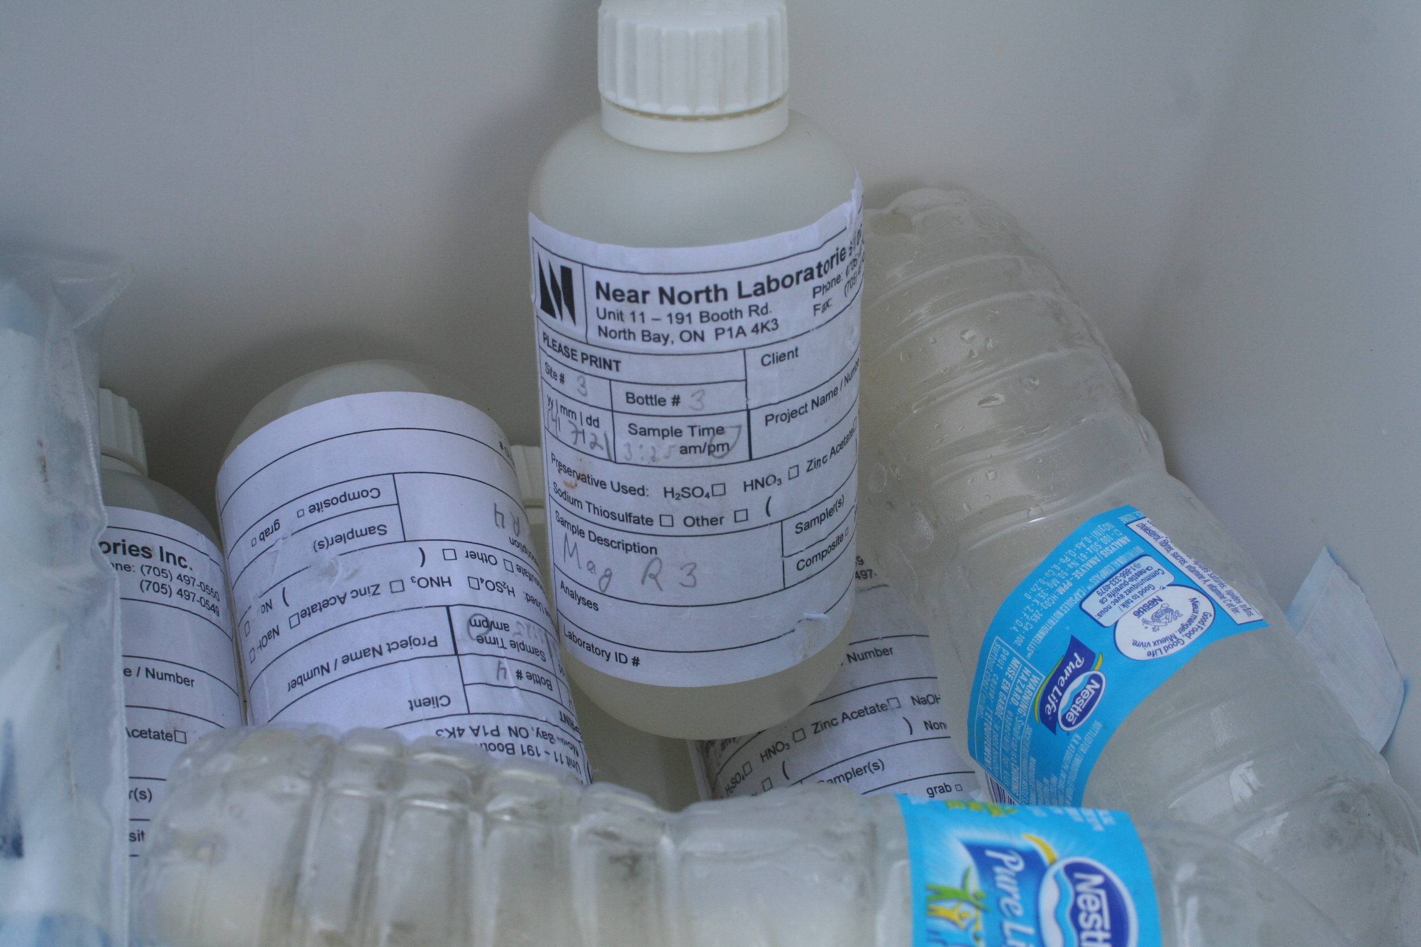

Slide 20
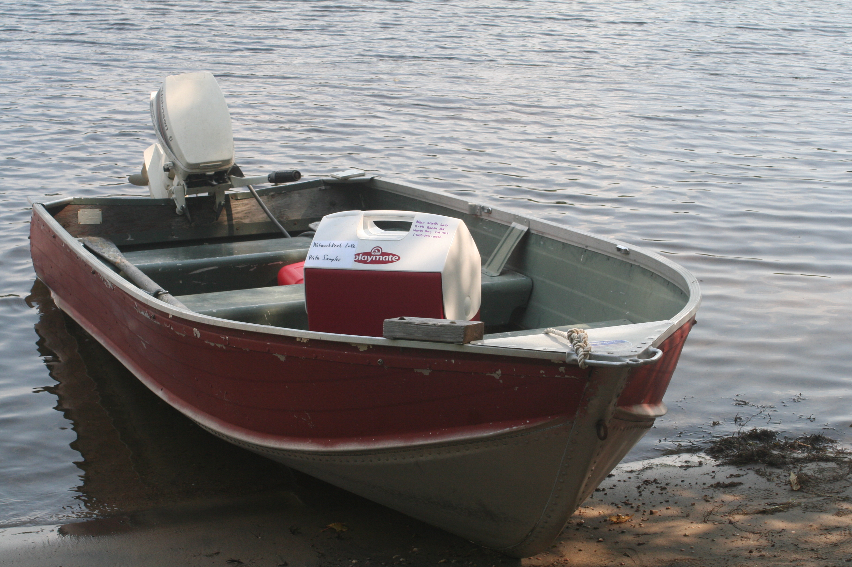
SS
Minnow

Slide 22
Summary and Plans
In 2014, pH and dissolved ion concentrations are lower compared to 2013.
Lower oxygen levels in deep water have been observed in Shanty Bay, water quality looks good at Lovesick Rapids where the Magnetawan River enters WWK.
E coli levels were slightly elevated in Shanty Bay and at Lovesick Rapids (Mag River discharge) in early July, but have declined (E coli comes and goes).

Slide 23
Three more E coli sampling trips will be made this year.
Water quality meter readings will be taken in August and September.
Phosphorus will be measured in August at four locations in WWK.

